Slide 4
Representing Graphs and
Graph Isomorphism

Slide 5
Representing Graphs
a
a
d
b
b
d
c
c
Vertex
Adjacent Vertices
Initial Vertex
Terminal Vertices
a
b, c, d
a
c
b
a, d
b
a
c
a, d
c
d
a, b, c
d
a, b, c

Slide 6
Representing Graphs
Definition: Let G = (V, E) be a simple graph with |V| = n. Suppose that the vertices of G are listed in arbitrary order as v₁, v₂, …, v_{n}.
The adjacency matrix A (or A_{G}) of G, with respect to this listing of the vertices, is the n×n zero-one matrix with 1 as its (i, j) entry when v_{i} and v_{j} are adjacent, and 0 otherwise.
In other words, for an adjacency matrix A = [a_{ij}],
a_{ij} = 1 if {v_{i}, v_{j}} is an edge of G,
a_{ij} = 0 otherwise.

Slide 7
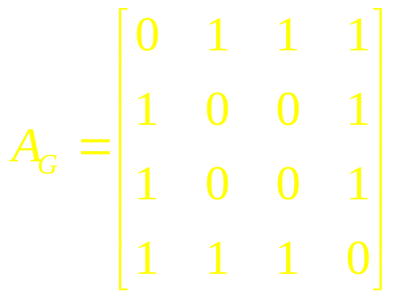
Representing Graphs
Example: What is the adjacency matrix A_{G} for the following graph G based on the order of vertices a, b, c, d ?
a
b
d
c
Solution:
Note: Adjacency matrices of undirected graphs are always symmetric.

Slide 8
Representing Graphs
Definition: Let G = (V, E) be an undirected graph with |V| = n. Suppose that the vertices and edges of G are listed in arbitrary order as v₁, v₂, …, v_{n} and e₁, e₂, …, e_{m}, respectively.
The incidence matrix of G with respect to this listing of the vertices and edges is the n×m zero-one matrix with 1 as its (i, j) entry when edge e_{j} is incident with v_{i}, and 0 otherwise.
In other words, for an incidence matrix M = [m_{ij}],
m_{ij} = 1 if edge e_{j} is incident with v_{i}
m_{ij} = 0 otherwise.

Slide 9
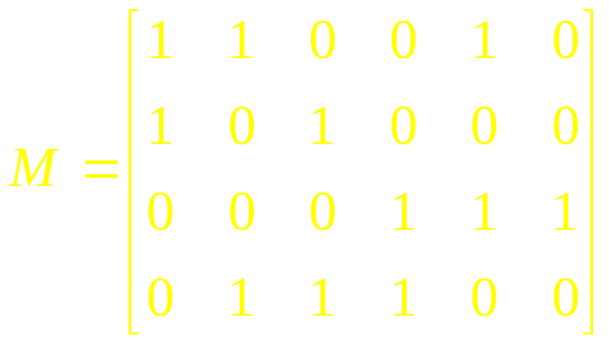
Representing Graphs
Example: What is the incidence matrix M for the following graph G based on the order of vertices a, b, c, d and edges 1, 2, 3, 4, 5, 6?
a
1
2
b
d
3
5
4
c
6
Solution:
Note: Incidence matrices of directed graphs contain two 1s per column for edges connecting two vertices and one 1 per column for loops.

Slide 10
Isomorphism of Graphs
Definition: The simple graphs G₁ = (V₁, E₁) and G₂ = (V₂, E₂) are isomorphic
if there is a one-to-one from V₁ to V₂ with the property that a and b are adjacent in G₁ if and only if f(a) and f(b) are adjacent in G₂, for all a and b in V₁.
In other words, G₁ and G₂ are isomorphic if their vertices can be ordered in such a way that the adjacency matrices M_{G1} and M_{G2} are identical.

Slide 11
In other words when two simple graphs are isomorphic, there is a one-to-one correspondence between vertices of the two graphs that preserves the adjacency relationship.
If a and b are adjacent in G1 if and only if f(a) and f(b) are adjacent in G2 for all a and b in V1

Slide 12
Isomorphism of Graphs
From a visual standpoint, G₁ and G₂ are isomorphic if they can be arranged in such a way that their displays are identical (of course without changing adjacency).
Unfortunately, for two simple graphs, each with n vertices, there are n! possible isomorphisms that we have to check in order to show that these graphs are isomorphic.
However, showing that two graphs are not isomorphic can be easy.

Slide 13
Isomorphism of Graphs
For this purpose we can check invariants, that is, properties that two isomorphic simple graphs must both have.
For example, they must have
the same number of vertices,
the same number of edges, and
the same degrees of vertices.
Note that two graphs that differ in any of these invariants are not isomorphic, but two graphs that match in all of them are not necessarily isomorphic.

Slide 14
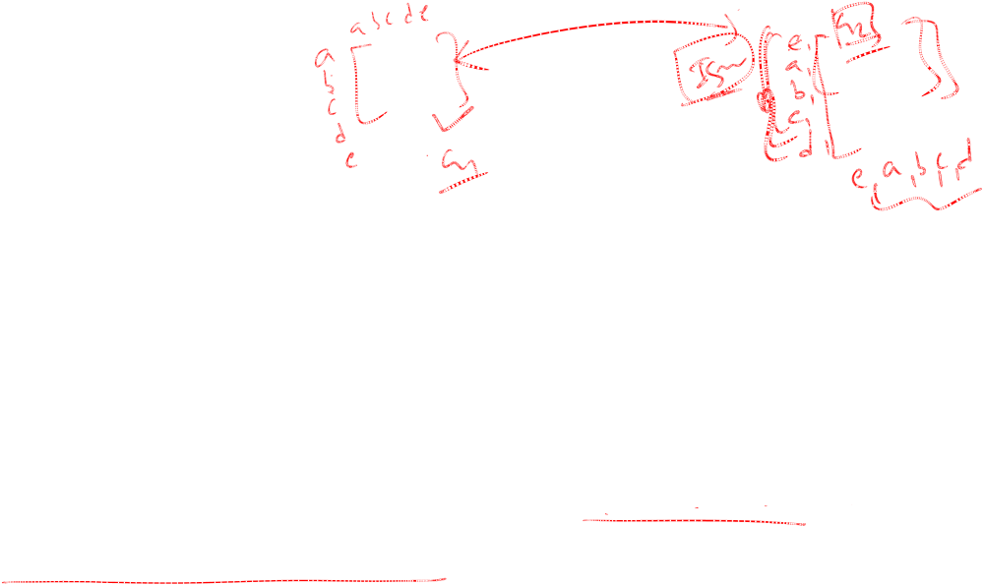
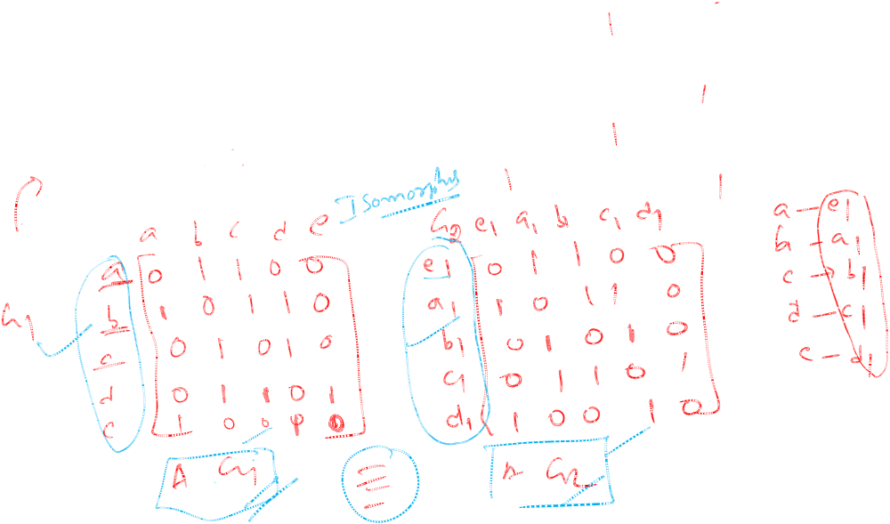
Isomorphism of Graphs
Example I: Are the following two graphs isomorphic?
a
a
b
e
e
b
c
d
c
d
Solution: Yes, they are isomorphic, because they can be arranged to look identical. You can see this if in the right graph you move vertex b to the left of the edge {a, c}. Then the isomorphism f from the left to the right graph is: f(a) = e, f(b) = a,
f(c) = b, f(d) = c, f(e) = d.

Slide 15
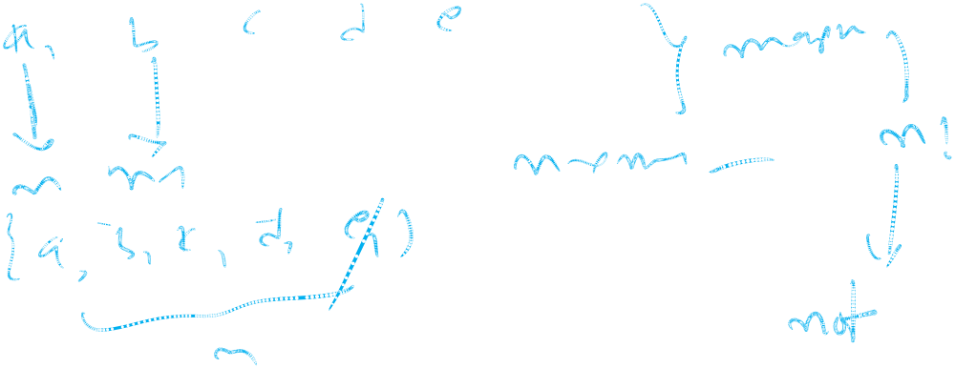

Slide 20
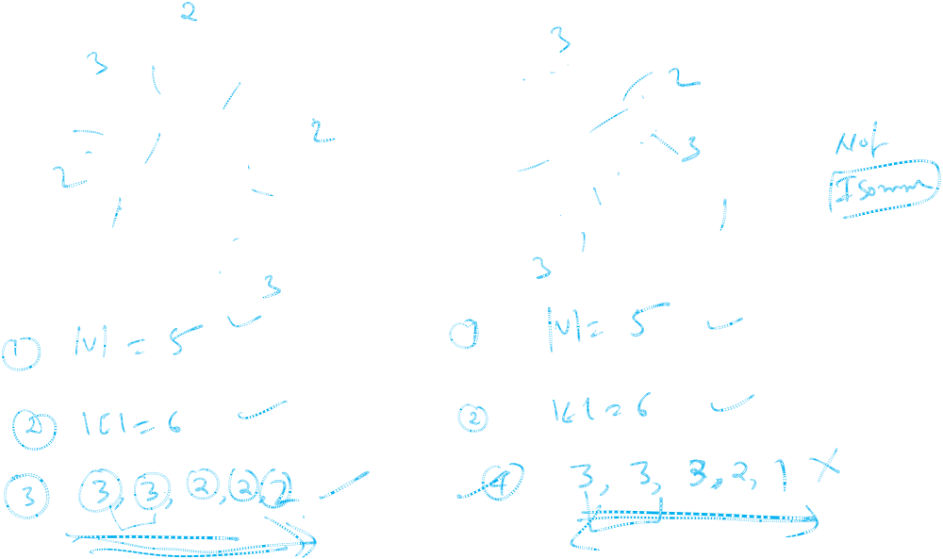
Isomorphism of Graphs
Example II: How about these two graphs?
a
a
b
e
e
b
c
c
d
d
Solution: No, they are not isomorphic, because they differ in the degrees of their vertices.
Vertex d in right graph is of degree one, but there is no such vertex in the left graph.

Slide 21
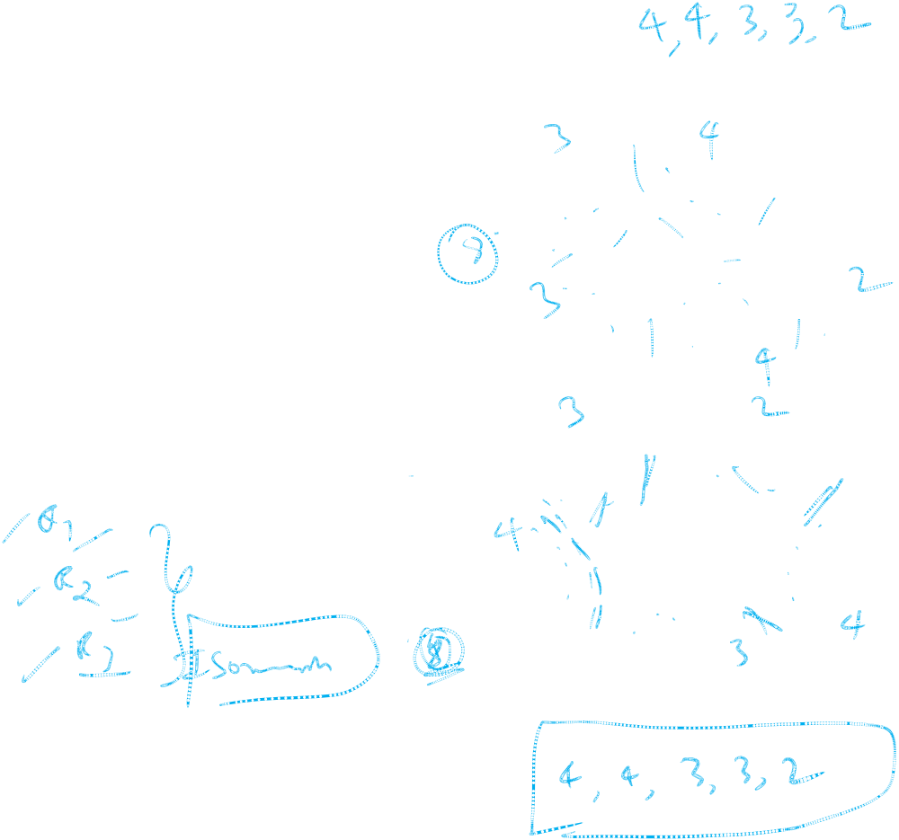
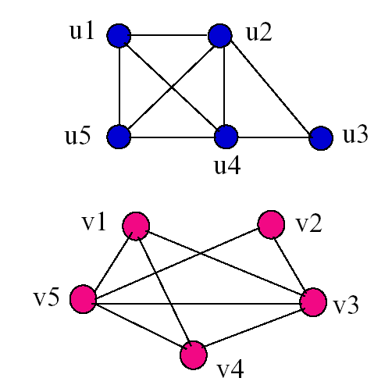
Examples
Determine if the following two graphs G₁ and G₂ are isomorphic:

